Slide 1
Subject Name: Fundamental of Computing
Subject Code: CS16
Term: ODD SEMESTER 2020
UNIT-2
M.S. Ramaiah Institute of Technology
(Autonomous Institute, Affiliated to VTU)
Department of Computer Science and Engineering
Faculty:
Darshana A Naik
Shilpa H
Sunitha R S

Slide 2
Unit 2
Operators and Expressions: Arithmetic Operators, Relational Operators, Logical Operators, Assignment Operators, Increment and Decrement Operators, Conditional Operators, Arithmetic Expressions, Evaluation of Expressions, Precedence of Arithmetic Operators, Type Conversions in Expressions, Operator Precedence and Associatively. Control Structures in C: Algorithm Development, Decision Making and Branching: Simple IF statement, IF..Else Statement, Nesting of IF...Else, The Else IF Ladder, The Switch Statements. The GOTO Statement. Decision Making and Looping: Introduction, The While Statement, The DO statement, The FOR statement, Jumps in Loops.

Slide 3
Operators and Expressions
C supports a rich set of operators. Operators are used in programs to manipulate data and variables.
They usually form a part of the mathematical of logical expressions.

Slide 4
Categories of Operators
Arithmetic operators
Relational operators
Logical operators
Assignment operators
Increment and Decrement operators
Conditional operators
Bitwise operators
Special operators

Slide 5
ARITHMETIC OPERATORS
The operators are
■ + (Addition)
  - (Subtraction)
  * (Multiplication)
  / (Division)
  % (Modulo division)
The Division operator produces the quotient.
The modulo division produces the remainder of an integer division.
The modulo division operator cannot be used on floating point
data.
Note: C does not have any operator for exponentiation

Slide 6
Integer Arithmetic
When both the operands in a single arithmetic expression are integers, the expression is called an integer expression , and the operation is called integer arithmetic.
If a=14 and b=4, then
  a-b=10
  a+b=18
  a*b=56
  a/b=3
  a%b=2

Slide 7
Integer Arithmetic
What is the results of the following?
6/7=?
3/7=?
21/3=?

Slide 8
Integer Arithmetic
During modulo division the sign of the result is always the sign of the first operand.
-14 % 3 = -2
-14 % -3 = -2
14 % -3 = 2

Slide 9
Real Arithmetic
An arithmetic operation involving only real operands is called real arithmetic.
If x and y are floats then we will have
  1) x = 6.0 / 7.0 = 0.857143
  2) y = 1.0 / 3.0 = 0.333333
The operator % cannot be used with real operands.

Slide 10
Mixed-mode Arithmetic
When one of the operands is real and the other is integer, the expression is called a mixedmode arithmetic expression and its result is always a real number.
Eg: 1) 15 / 10.0 = 1.5

Slide 11
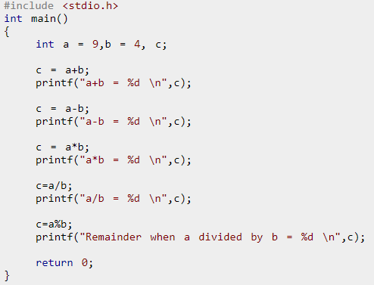
C Program for the arithmetic operators
What is the output of the following?

Slide 12
RELATIONAL OPERATORS
Comparisons can be done with the help of relational operators.
The expression containing a relational operator is termed as a relational expression.
The value of a relational expression is either one or zero.

Slide 13
RELATIONAL OPERATORS
1) < (is less than)
2) <= (is less than or equal to)
3) > (is greater than)
4) >= (is greater than or equal to)
5) = = (is equal to)
6) != (is not equal to)

Slide 14
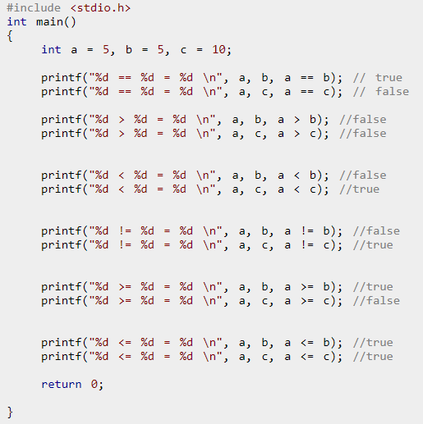
Relational Operators example in C

Slide 15
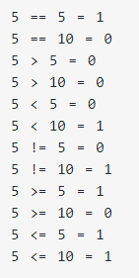
Relational Operators example in C

Slide 16
LOGICAL OPERATORS
Following are three logical operators.
  && (logical AND)
  || (logical OR)
  ! (logical NOT)
Eg:
1) if(age>55 && sal<1000)
2) if(number<0 || number>100)

Slide 17
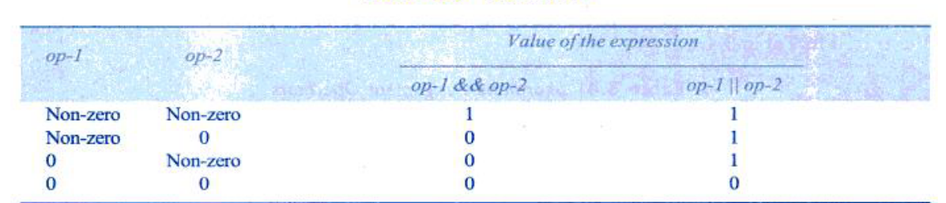
Truth Table

Slide 18
LOGICAL OPERATORS
If c = 5 and d = 2 then, expression
  ((c == 5) && (d > 5)) equals to 0.
If c = 5 and d = 2 then, expression
  ((c == 5) || (d > 5)) equals to 1.
If c = 5 then, expression
  ! (c == 5) equals to 0.

Slide 19
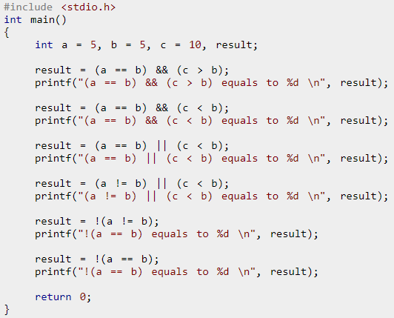
LOGICAL OPERATORS-
Example

Slide 20
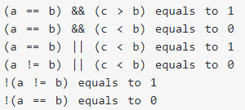
LOGICAL OPERATORS-
Example- Output
Output

Slide 21
ASSIGNMENT OPERATORS
The usual assignment operator is ‘=’.
In addition, C has a set of ‘shorthand’ assignment operators.
Eg: x += y+1;
This is same as the statement x=x+(y+1);

Slide 22
ASSIGNMENT OPERATORS
a + =1 → a = a + 1
a - = 1 →a = a – 1
a *= n + 1 → a = a * (n+1)
a /= n + 1 → a = a / (n+1)
a %= b → a = a % b

Slide 23
INCREMENT AND DECREMENT OPERATORS
These are the increment and decrement operator:
■ ++ and --
The operator ++ adds 1 to the operands while -- subtracts 1.
It takes the following form:
■ ++m; or m++
  --m; or m—
x= 4++; // gives error, because 4 is constant

Slide 24
INCREMENT AND DECREMENT
OPERATORS- Example
void main()
{
int x,i; i=10;
x=i++;
printf("x: %d",x);
printf("i: %d",i);
}

Slide 25
INCREMENT AND DECREMENT
OPERATORS- Example
void main()
{
int x,i; i=10;
x=i++;
printf("x: %d",x);
printf("i: %d",i);
}
Output:
10
11

Slide 26
INCREMENT AND DECREMENT
OPERATORS- Example
void main()
{
int x,i; i=10;
x=++i;
printf("x: %d",x);
printf("i: %d",i);
}

Slide 27
INCREMENT AND DECREMENT
OPERATORS- Example
void main()
{
int x,i; i=10;
x=++i;
printf("x: %d",x);
printf("i: %d",i);
}
Output:
11
11

Slide 28
INCREMENT AND DECREMENT
OPERATORS- Example
void main()
{
int x,i; i=10;
x=i--;
printf("x: %d",x);
printf("i: %d",i);
}

Slide 29
INCREMENT AND DECREMENT
OPERATORS- Example
void main()
{
int x,i; i=10;
x=i--;
printf("x: %d",x);
printf("i: %d",i);
}
Output:
10
9

Slide 30
INCREMENT AND DECREMENT
OPERATORS- Example
void main()
{
int x,i; i=10;
x=--i;
printf("x: %d",x);
printf("i: %d",i);
}

Slide 31
INCREMENT AND DECREMENT
OPERATORS- Example
void main()
{
int x,i; i=10;
x=--i;
printf("x: %d",x);
printf("i: %d",i);
}
Output:
9
9

Slide 32
INCREMENT AND DECREMENT
OPERATORS- Example
void main()
{
int x,a,b,c; a = 2;
b = 4;
c = 5;
x = a-- + b++ -++c;
printf("x: %d",x);
}
94

Slide 33
INCREMENT AND DECREMENT
OPERATORS- Example
void main()
{
int x,a,b,c; a = 2;
b = 4;
c = 5;
x = a-- + b++ -++c; ^{Output: 0}
printf("x: %d",x);
}
95

Slide 34
INCREMENT AND DECREMENT
OPERATORS- Example
void main()
{
int x,a,b,c; a = 2;
b = 4;
c = 5;
x = a-- + b++ -++c; ^{Output: 0}
printf("x: %d",x);
}
34

Slide 35
Increment and decrement operators
void main()
{
int a=5;
printf(“a: %d",++a);
printf(“a: %d", a++);
}
a=a+1=5+1=6
a=a=6
a=a=6 //Displayed a=a+1=7
35

Slide 36
Increment and decrement operators
void main()
{
int a=5;
printf(“a: %d",++a);
a:6
a:6
printf(“a: %d", a++);
printf(“a: %d", a);
}
a:7
36

Slide 37
Exercise-What is the output?
#include <stdio.h> int main()
{
int a=5;
printf("a: %d\n",++a, a++); return 0;
}
37

Slide 38
Exercise-What is the output?
#include <stdio.h> int main()
{
int a=5;
printf("a: %d\n",++a, a++); return 0;
O/p: a:7
}
38

Slide 39
Exercise-What is the output?
#include <stdio.h>
int main()
{
int a=5;
printf("a: %d\n",a--);
printf("a: %d\n",--a);
return 0;
}
39

Slide 40
Exercise-What is the output?
#include <stdio.h>
int main()
{
int a=5;
printf("a: %d\n",a--);
printf("a: %d\n",--a);
return 0;
a:5
a:3
}
40

Slide 41
Exercise-What is the output?
#include <stdio.h>
int main()
{
int a=5,x;
x=a--;
printf("a: %d\n",x);
printf("a: %d\n",a);
return 0;
}
41

Slide 42
Exercise-What is the output?
#include <stdio.h>
int main()
{
int a=5,x;
x=a--;
printf("a: %d\n",x);
printf("a: %d\n",a);
a:5
return 0;
a:4
}
42

Slide 43
Exercise-What is the output?
#include <stdio.h> int main()
{
int a=5,x;
x=a--;
printf("a: %d\n",a);
printf("a: %d\n",x);
x=--a;
printf("a: %d\n",a);
printf("a: %d\n",x); return 0;
}
43

Slide 44
Exercise-What is the output?
#include <stdio.h>
int main()
{
int a=5,x;
x=a--;
printf("a: %d\n",a);
printf("a: %d\n",x);
x=--a;
printf("a: %d\n",a);
printf("a: %d\n",x); return 0;
}
a:4
a:5
a:3
a:3
44

Slide 45
Exercise-What is the output?
#include <stdio.h>
int main()
{
int a=5;
printf("%d",a--,a++,--a);
return 0;
}
45

Slide 46
Exercise-What is the output?
#include <stdio.h>
int main()
{
int a=5;
printf("%d",a--,a++,--a); return 0;
a:5
}
46

Slide 47
Exercise-What is the output?
#include <stdio.h>
int main()
{
int a=5;
printf("%d%d",a--,a++,--a);
return 0;
}
47

Slide 48
Exercise-What is the output?
#include <stdio.h>
int main()
{
int a=5;
printf("%d%d",a--,a++,--a);
return 0;
}
a:5, 4
48

Slide 49
Exercise-What are the values of n1, n2, n3 and n4 at the end?
int n1,n2,n3,n4;
n1 = 1;
n2 = ++n1;
n3 = ++n1;
n4 = n1++;
49

Slide 50
Exercise-What are the values of n1, n2, n3 and n4 at the end?
int n1,n2,n3,n4;
n1 = 1;
n2 = ++n1;
n3 = ++n1;
n4 = n1++;
n1: 4
n2: 2
n3:3
n4: 3
50

Slide 51
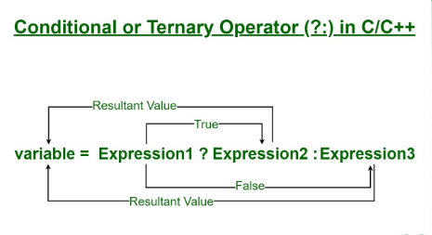
Conditional Operators

Slide 52
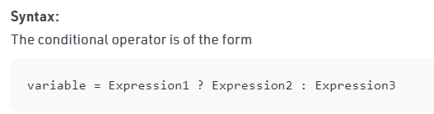
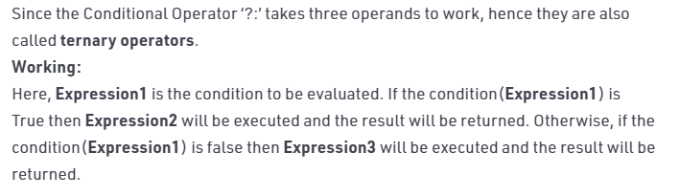
Syntax

Slide 53
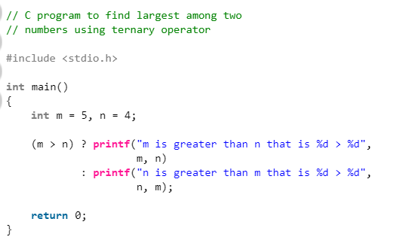
Example

Slide 54
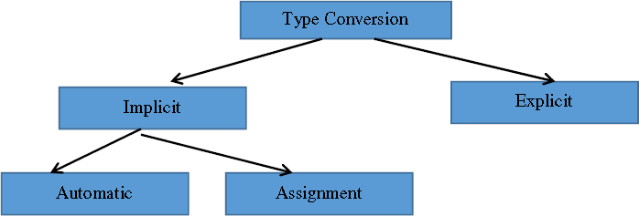
TYPE CONVERSION IN EXPRESSIONS
54

Slide 55
Automatic Type Casting
1. char and short operands are converted to int
2. Lower data types are converted to the higher data types and result is of higher type.
3. The conversions between unsigned and signed
types may not yield intuitive results.
4. Example
float f; double d; long l;
int i; short s;
Hierarchy
Double float long Int
Short and char
d + f f will be converted to double
i / s s will be converted to int
l / i i is converted to long; long result
55

Slide 56
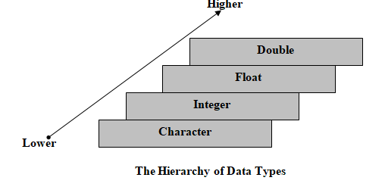
Hierarchy of Data Types

Slide 57
Assignment type casting
If types of the operand in an assignment expression is different, then the operand on the right-hand side will be converted to the type of left-hand operand according to the following rules.
  int i = 'z';
  i=122;
57

Slide 58
Explicit Type Casting
The general form of a type casting operator is
(type-name) expression
It is generally a good practice to use explicit casts than to rely on automatic type conversions.
Example
C = (float)9 / 5 * ( f – 32 )
float to int conversion causes truncation of fractional part
double to float conversion causes rounding of digits
long int to int causes dropping of the higher order bits.
116

Slide 59
Example on implicit type casting
#include<stdio.h> main ( )
{
int i=17;
char c=’c’; int sum; sum=i+c;
printf(“Value of sum:%d\n”,sum);
}
Output: Value of sum: 116
59

Slide 60
Example on explicit type casting
With explicit
int sum=17,count=5; float mean; mean=(float)sum/count; printf("Value of
mean:%f\n",mean);
Output:
Value of mean: 3.400000
Without explicit
int sum=17,count=5; float mean; mean=sum/count; printf("Value of
mean:%f\n",mean);
Output:
Value of mean: 3.000000
60

Slide 61
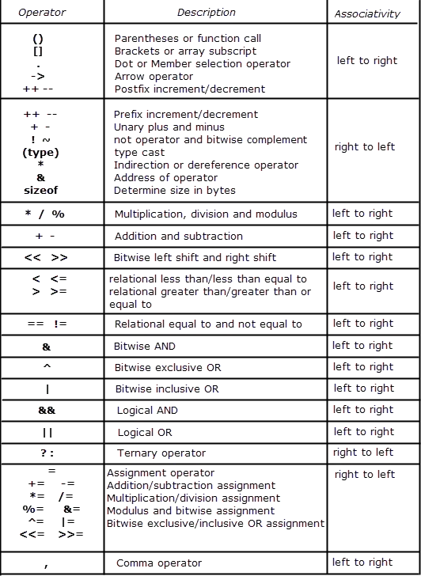
Operator Precedence and Associativity
Operator precedence: It dictates the order of evaluation of operators in an expression.
Associativity: It defines the order in which operators of the same precedence are evaluated in an expression. Associativity can be either from left to right or right to left.
Consider the following example:
24+5*4
Here we have two operators + and *, Which operation do you think will be evaluated first, addition or multiplication? If the addition is applied first then answer will be 116 and if the multiplication is applied first answer will be 44. To answer such question we need to consult the operator precedence table.

Slide 62
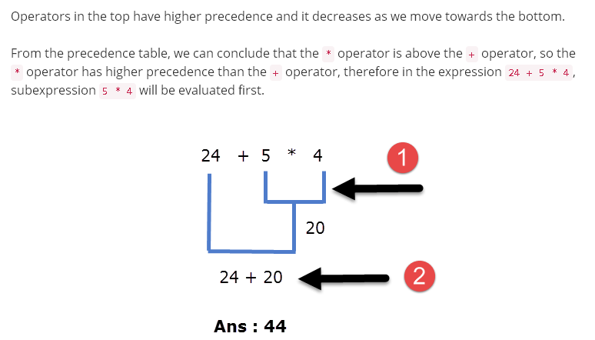
Examples:

Slide 63
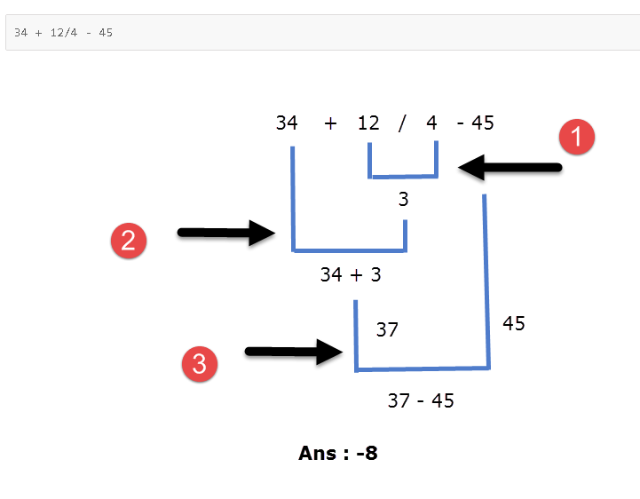
Examples:

Slide 64
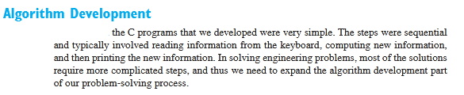

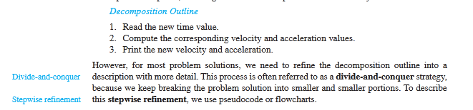
Algorithm Development

Slide 65
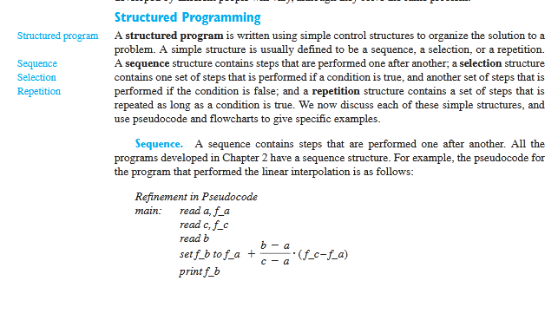
Structured Programming

Slide 66
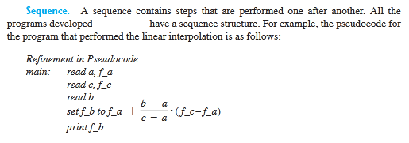
Sequence

Slide 67
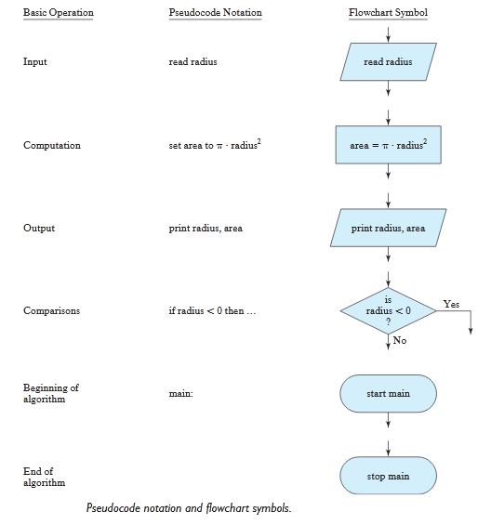

Slide 68
Decision Making and Branching
Simple if statement
IF ELSE Statement
Nesting of IF-else statement
The else-if statement

Slide 69
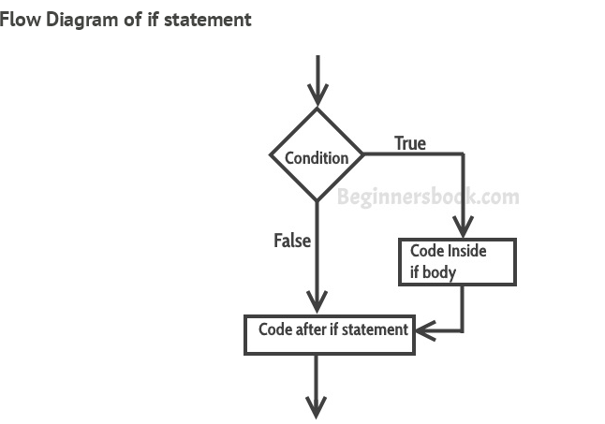
Simple if Statement
The statements inside the body of “if” only execute if the given condition returns true. If the condition returns false then the statements inside “if” are skipped.

Slide 70
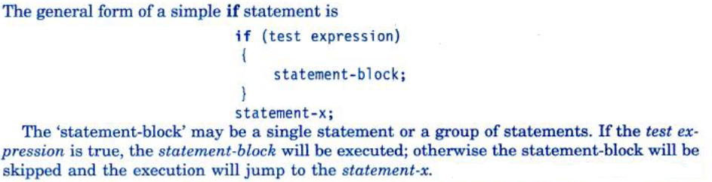
Syntax of Simple if statement

Slide 71
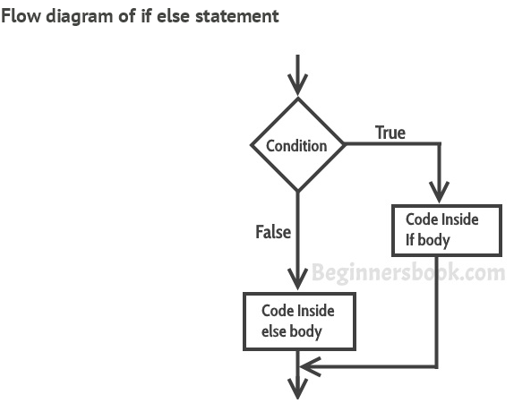
If else Statement
If condition returns true then the statements inside the body of “if” are executed and the statements inside body of “else” are skipped.
If condition returns false then the statements inside the body of “if” are skipped and the statements in “else” are executed.

Slide 72
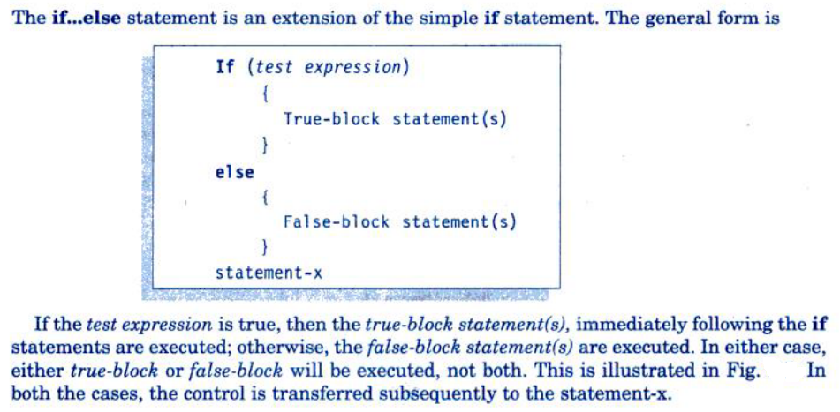
Syntax of if else statement

Slide 73
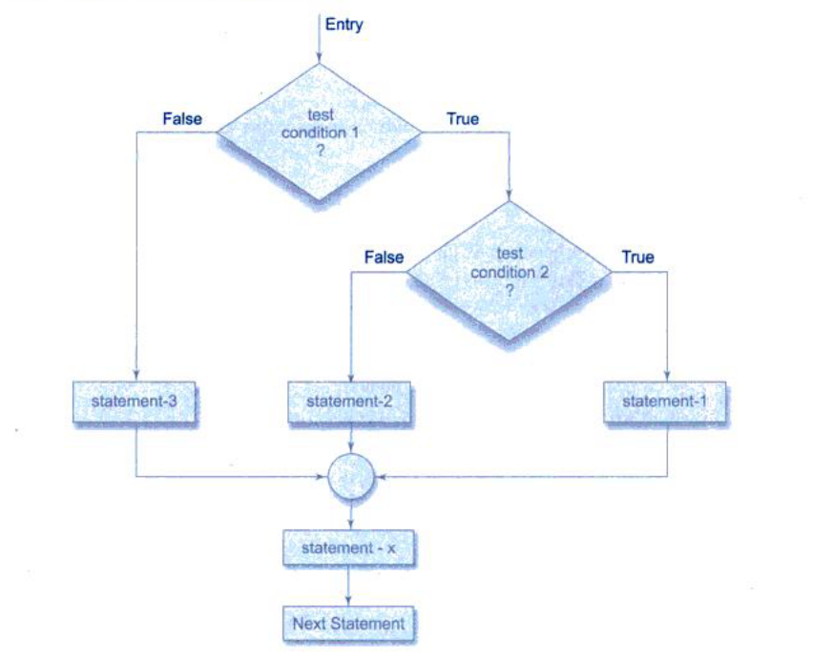
Nesting of if-else statement

Slide 74
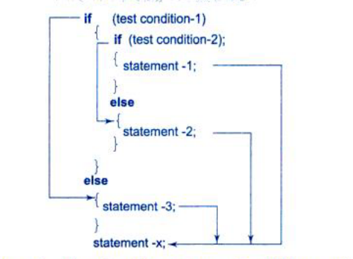
Syntax of nesting of if-else statement

Slide 75
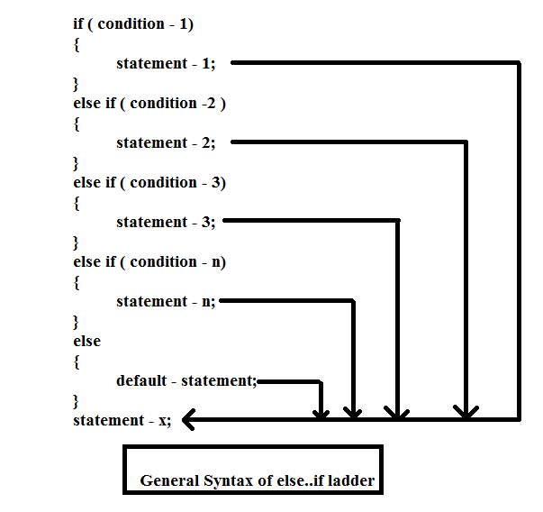
Syntax of else if ladder

Slide 76
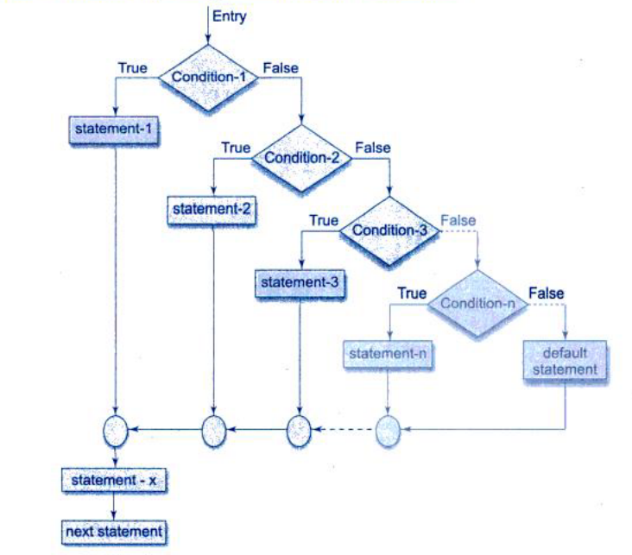
Nesting of else if ladder ladder

Slide 77
Switch statement in C
Department of Computer Science and Engineering

Slide 78
The switch Multiple-Selection Structure
switch ( integer expression )
{
case constant₁ :
statement(s)
break ;
case constant₂ :
statement(s)
break ;
. . .
default: :
statement(s)
break ;
}
Department of Computer Science and Engineering

Slide 79
Case labels in switch
Which of the following are valid usages of case labels.
  case 1+1: //valid
  case ‘A’://valid
  case 67://valid
  case var: //valid
  case num1: //valid
  case 10://valid
  case 20+20: //valid
  case 10.12 //invalid
  case 7.5//invalid
Department of Computer Science and Engineering

Slide 80
Programs
Write and
execute a C
given alphabet is vowel or
program to find
whether a
consonant using switch.
Department of Computer Science and Engineering

Slide 81
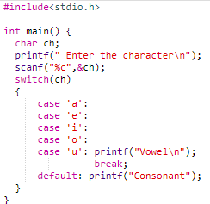
Programs
Department of Computer Science and Engineering

Slide 82
The goto Statement
goto causes an unconditional jump to a labeled statement somewhere in the current function.
Form of a labeled statement.
label: statement
Where label is an identifier.
Department of Computer Science and Engineering

Slide 83
Goto Example
int main()
{
char ch;
int count=1;
read:
printf(" Enter the character\n"); scanf("%c",&ch);
count++;
printf("Entered character is %c\n",ch); if(count<=3)
goto read; printf("End");
}
Department of Computer Science and Engineering

Slide 84
The goto Statement
Write and execute a C program to evaluate the square root for five numbers using goto statement.
Department of Computer Science and Engineering

Slide 85
The goto Statement
#include<stdio.h>
#include<math.h>
int main() {
int num;
int count=1;
read: printf(" Enter the number\n");
scanf("%d",&num);
if(count<=5)
{
count++;
printf(" The square root of %d is %f\n",num,sqrt(num));
goto read;
}
printf("End");
}
Department of Computer Science and Engineering

Slide 86
Loops – While, Do, For
Repetition Statements
  While
  Do
  For
Department of Computer Science and Engineering

Slide 87
The while Statement
A while statement has the following syntax:
while ( condition )
statement;
If the condition is true, the statement is executed
Then the condition is evaluated again, and if it is still true, the statement is executed again
The statement is executed repeatedly until the condition becomes false
Department of Computer Science and Engineering

Slide 88
Logic of a while Loop
condition evaluated
true
false
statement
Department of Computer Science and Engineering
5

Slide 89
The while Statement
An example of a while statement:
int count = 0; while (count < 2)
{
printf("Welcome to Java!");
count++;
}
If the condition of a while loop is false initially, the statement is never executed
Therefore, the body of a while loop will execute zero or more times
Department of Computer Science and Engineering
13

Slide 90
Trace while Loop
Initialize count
int count = 0; while (count < 2)
{
printf("Welcome to C!"); count++;
}
Department of Computer Science and Engineering

Slide 91
Trace while Loop, cont.
(count < 2) is true
int count = 0;
while (count < 2)
{
printf("Welcome to C!"); count++;
}
Department of Computer Science and Engineering

Slide 92
Trace while Loop, cont.
int count = 0; while (count < 2)
{
Print Welcome to Java
printf("Welcome to C!");
count++;
}
Department of Computer Science and Engineering

Slide 93
Trace while Loop, cont.
int count = 0; while (count < 2)
{
printf("Welcome to C!");
Increase count by 1
count is 1 now
count++;
}
Department of Computer Science and Engineering

Slide 94
Trace while Loop, cont.
(count < 2) is still true since count
int count = 0;
is 1
while (count < 2)
{
printf("Welcome to C!"); count++;
}
Department of Computer Science and Engineering

Slide 95
Trace while Loop, cont.
int count = 0; while (count < 2)
{
Print Welcome to Java
printf("Welcome to C!");
count++;
}
Department of Computer Science and Engineering

Slide 96
Trace while Loop, cont.
int count = 0; while (count < 2)
{
printf("Welcome to C!");
Increase count by 1 count is 2 now
count++;
}
Department of Computer Science and Engineering

Slide 97
Trace while Loop, cont.
animation
(count < 2) is false since count is 2
int count = 0;
now
while (count < 2)
{
printf("Welcome to C!"); count++;
}
Department of Computer Science and Engineering

Slide 98
Trace while Loop
int count = 0; while (count < 2)
{
printf("Welcome to C!"); count++;
}
The loop exits. Execute the next
statement after the loop.
Department of Computer Science and Engineering

Slide 99
The do-while Statement
Syntax
do action
while (condition)
How it works:
  execute action
  if condition is true then execute action again
  repeat this process until condition evaluates to false.
action is either a single statement or a group of statements within braces.
action
true
condition
false
Department of Computer Science and Engineering

Slide 100
Trace do while Loop
Initialize count
int count = 0; do
{
printf("Welcome to C!"); count++;
} while (count < 2) ;
Department of Computer Science and Engineering
7

Slide 101
Trace do while Loop
int count = 0; do
{
Welcome to C!
printf("Welcome to C!");
count++;
} while (count < 2) ;
Department of Computer Science and Engineering
7

Slide 102
Trace do while Loop
int count = 0; do
{
printf("Welcome to C!");
count=1
count++;
} while (count < 2) ;
Department of Computer Science and Engineering
7

Slide 103
Trace do while Loop
int count = 0; do
{
printf("Welcome to C!"); count++;
1<2
} while (count < 2) ;
Department of Computer Science and Engineering
7

Slide 104
Trace do while Loop
int count = 0; do
{
printf("Welcome to C!"); count++;
} while (count < 2) ;
Welcome to C!
Department of Computer Science and Engineering
7

Slide 105
Trace do while Loop
int count = 0; do
{
printf("Welcome to C!");
Count=2
count++;
} while (count < 2) ;
Department of Computer Science and Engineering
7

Slide 106
Trace do while Loop
int count = 0; do
{
printf("Welcome to C!"); count++;
2<2
} while (count < 2) ;
Department of Computer Science and Engineering
7

Slide 107
Infinite Loops
An example of an infinite loop:
int count = 1;
while (count <= 25)
{
printf(count);
count = count - 1;
}
This loop will continue executing until the user externally interrupts the program.
Department of Computer Science and Engineering

Slide 108
Nested Loops
How many times will the string "Here" be printed?
count1 = 1;
while (count1 <= 3)
{
count2 = 1;
while (count2 <= 3)
{
printf ("Here");
count2++;
}
count1++;
}
Department of Computer Science and Engineering

Slide 109
What is the output of the following code?
#include<stdio.h> void main()
{
int val=1; do{
val++;
++val;
}while(val++>25);
printf("%d\n",val);
}
Department of Computer Science and Engineering

Slide 110
What is the output of the following code?
#include<stdio.h> void main()
{
int val=1; do{
val++;
++val;
}while(val++>25);
printf("%d\n",val);
}
Answer: 4
Department of Computer Science and Engineering

Slide 111
What is the output of the following code?
#include<stdio.h> int main()
{
int val=1; while(val<=5)
printf("Hi"); val++;
}
Department of Computer Science and Engineering

Slide 112
What is the output of the following code?
#include<stdio.h> int main()
{
int val=1; while(val<=5)
printf("Hi"); val++;
}
HiHiHiHiHiHiHiHiHiHiHiHiHiHiHiHiHiHiHiHiHiHiHiHiHiHiHiHiHiHi……………..
Department of Computer Science and Engineering

Slide 113
What is the output of the following code?
#include<stdio.h>
Hi
int main()
{
int val=1; while(val<=5)
{
printf("Hi"); val++;
}
}
Hi Hi Hi Hi
Department of Computer Science and Engineering

Slide 114
What is the output of the following code?
#include<stdio.h> int main()
{
int val=1; while(val<=5);
{
printf("Hi"); val++;
}
}
Department of Computer Science and Engineering

Slide 115
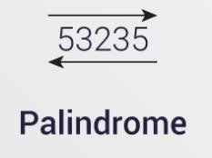
Programs
Write and execute a C program to read a number using keyboard, check whether a given number is palindrome or not using a while loop and display the result.
Department of Computer Science and Engineering

Slide 116
Programs
#include <stdio.h> int main()
{ int n, rev = 0, remainder, originalInteger; printf("Enter an integer: ");
scanf("%d", &n);
originalInteger = n; // reversed integer is stored in variable while( n!=0 )
{
remainder = n%10;
reversedInteger = reversedInteger*10 + remainder; n /= 10;
}
// palindrome if orignalInteger and reversedInteger are equal
if (originalInteger == reversedInteger)
printf("%d is a palindrome.", originalInteger); else
printf("%d is not a palindrome.", originalInteger); return 0;
}
Department of Computer Science and Engineering

Slide 117
For Loop
Syntax
Example
Department of Computer Science and Engineering

Slide 118
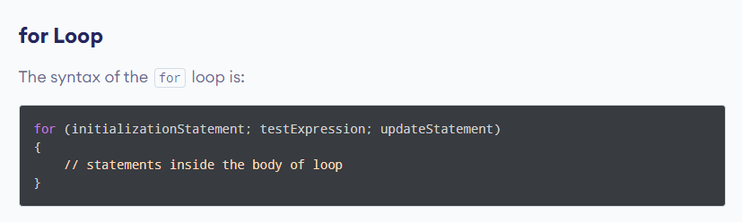
Syntax –for loop

Slide 119
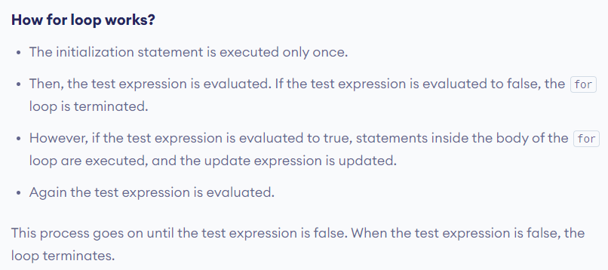
Syntax-for loop

Slide 120
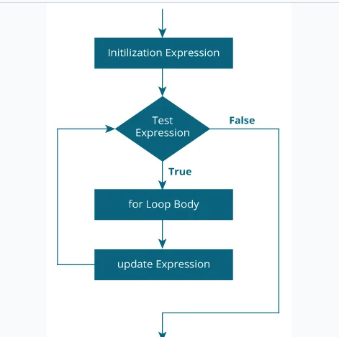
Flow chart- flow chart

Slide 121
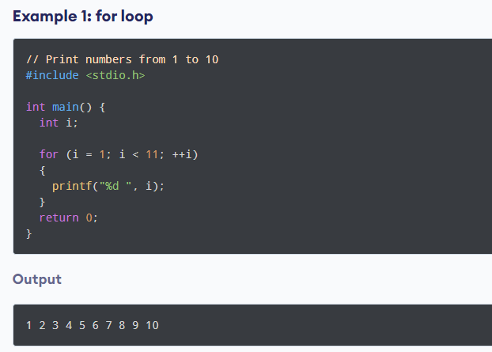
Example

Slide 122
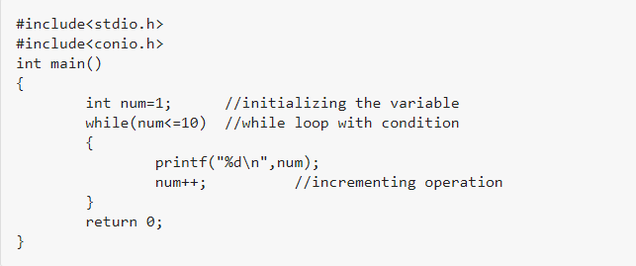
What is the output for the following?

Slide 123

Output

Slide 124
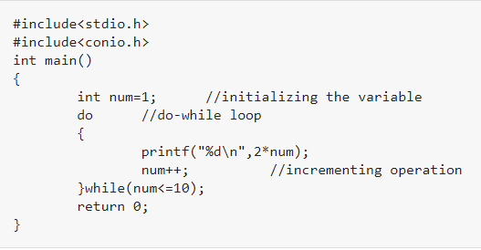
What is the output for the following code?

Slide 125

Output

Slide 126
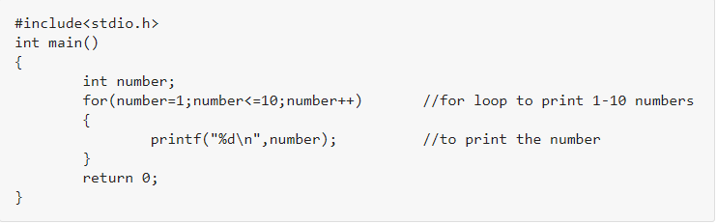
What is the output for the following code?

Slide 127

Output:

Slide 128
Programs
Write and execute a C program to read numbers using keyboard, find the sum of odd numbers and even numbers in first n natural numbers using a for loop.
Department of Computer Science and Engineering

Slide 129
Programs
Write and execute a C program to read a number using keyboard, find the factorial of a number using for loop and display the result.
Department of Computer Science and Engineering

Slide 130
Programs
Write and execute a C program to print.
1
12
123
1234
12345
Department of Computer Science and Engineering

Slide 131
Programs
Write and execute a C program to print.
#include <stdio.h>
void main( )
{
int i,j;
for(i=1;i<=5;i++)
{
for(j=1;j<=i;j++)
printf("%d",j);
printf("\n");
}
}
Department of Computer Science and Engineering

Slide 132
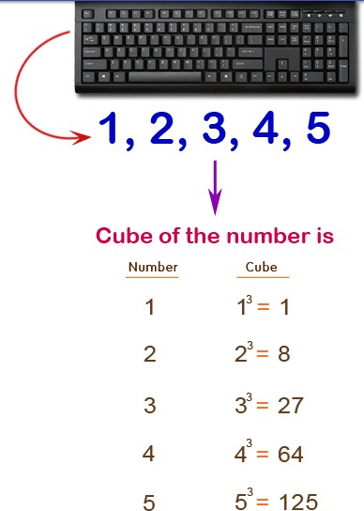
Programs
Write a program in C to display the cube of the number upto given an integer.
Input number of terms : 5
Expected Output :
Number is : 1 and cube of the 1 is :1 Number is : 2 and cube of the 2 is :8 Number is : 3 and cube of the 3 is :27 Number is : 4 and cube of the 4 is :64 Number is : 5 and cube of the 5 is :125
Department of Computer Science and Engineering

Slide 133
Solution
#include <stdio.h>
void main() {
int i,ctr;
printf("Input number of terms : ");
scanf("%d", &ctr); for(i=1;i<=ctr;i++) {
printf("Number is : %d and cube of the
%d is :%d \n",i,i, (i*i*i));
}
}
Department of Computer Science and Engineering

Slide 134
Programs
Write a program in C to display the multiplication table of a given integer.
Department of Computer Science and Engineering

Slide 135
#include <stdio.h>
void main()
{
int j,n;
printf("Input the number (Table to be calculated) : "); scanf("%d",&n);
printf("\n"); for(j=1;j<=10;j++)
{
printf("%d X %d = %d \n",n,j,n*j);
}
}
Department of Computer Science and Engineering

Slide 136
Programs
Write and execute a C program to read two numbers using keyboard, find GCD and LCM of two numbers using a do-while loop and display the result.
Department of Computer Science and Engineering

Slide 137
Jumps in Loops
The continue statement is used inside loops.
When a continue statement is encountered inside a loop, control jumps to the beginning of the loop for next iteration,
– skipping the execution of statements inside the body of loop for the current iteration.
Department of Computer Science and Engineering

Slide 138
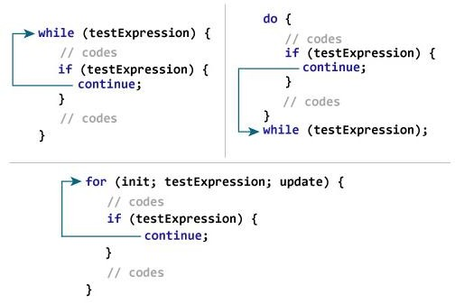
Continue statement
Department of Computer Science and Engineering

Slide 139
Continue Example
int main()
{
for (int j=0; j<=8; j++)
{
if (j==4)
continue; printf("%d ", j);
} return 0;
}
Output
0 1 2 3 5 6 7 8
Department of Computer Science and Engineering

Slide 140
Continue Example
int main()
{
int counter=10; while (counter >=0)
{
if (counter==7)
{
counter--; continue;
}
printf("%d ", counter);
counter--;
}
Output
10 9 8 6 5 4 3 2 1 0
return 0;
}
Department of Computer Science and Engineering

Slide 141
Continue Example- Guess the output
int main()
{
int j=0; do
{
if (j==7)
{
j++;
continue;
}
printf("%d ", j);
j++;
}while(j<10);
return 0;
}
Department of Computer Science and Engineering

Slide 142
Continue Example
int main()
{
int j=0; do
{
if (j==7)
{
j++;
continue;
}
printf("%d ", j);
j++;
}while(j<10); return 0;
0 1 2 3 4 5 6 8 9
}
Department of Computer Science and Engineering

Slide 143
C – break statement
It is used to come out of the loop instantly.
When a break statement is encountered inside a loop, the control directly comes out of loop and the loop gets terminated.
It is used with if statement, whenever used inside loop.
This can also be used in switch case control structure. Whenever it is encountered in switch- case block, the control comes out of the switch- case.
Department of Computer Science and Engineering

Slide 144
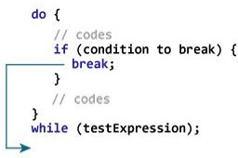
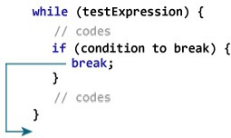
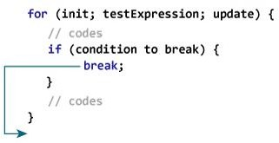
C – break statement
Department of Computer Science and Engineering

Slide 145
Break Example- Guess the output
int main()
{
int num =0; while(num<=100)
{
printf("value of variable num is: %d\n", num);
if (num==2)
{
break;
}
num++;
}
printf("Out of while-loop");
return 0;
}
Department of Computer Science and Engineering

Slide 146
Break Example
int main()
{
int num =0; while(num<=100)
{
printf("value of variable num is: %d\n", num);
if (num==2)
{
Value of variable num is 0 Value of variable num is 1 Value of variable num is 2 Out of while loop
break;
}
num++;
}
printf("Out of while-loop");
return 0;
}
Department of Computer Science and Engineering

Slide 147
Break Example- Guess the output
int main()
{
int var;
for (var =100; var>=10; var --)
{
printf("var: %d\n", var);
if (var==99)
{
break;
}
}
printf("Out of for-loop"); return 0;
}
Department of Computer Science and Engineering

Slide 148
Break Example- Guess the output
int main()
{
int var;
for (var =100; var>=10; var --)
{
printf("var: %d\n", var);
if (var==99)
{
break;
}
var: 100
var: 99 Out of for loop
}
printf("Out of for-loop"); return 0;
}
Department of Computer Science and Engineering

Slide 149
Interesting examples in for loop
main()
{
int num=10; for(;--num;)
printf(“%d”,num);
}
9 8 7 6 5 4 3 2 1
Department of Computer Science and Engineering

Slide 150
Interesting examples in for loop
main()
{
int i; for(i=0;i<5;i++);
printf("%d ",i);
}
6
Department of Computer Science and Engineering

Slide 151
Interesting examples in for loop
#include<stdio.h> main()
{
int x=1,y=1;
for(;y;printf("%d %d\n",x,y))
y = x++ <= 5;
}
2 1
3 1
4 1
5 1
6 1
7 0
Department of Computer Science and Engineering

Slide 152
Thank you

